Slide 1
Bayes babes:
Exploring the switching observer model
Laquitaine, S., & Gardner, J. L. (2017). A Switching Observer for Human Perceptual Estimation. Neuron, 97(2), 462-474.e6. https://doi.org/10.1016/j.neuron.2017.12.011

Slide 2
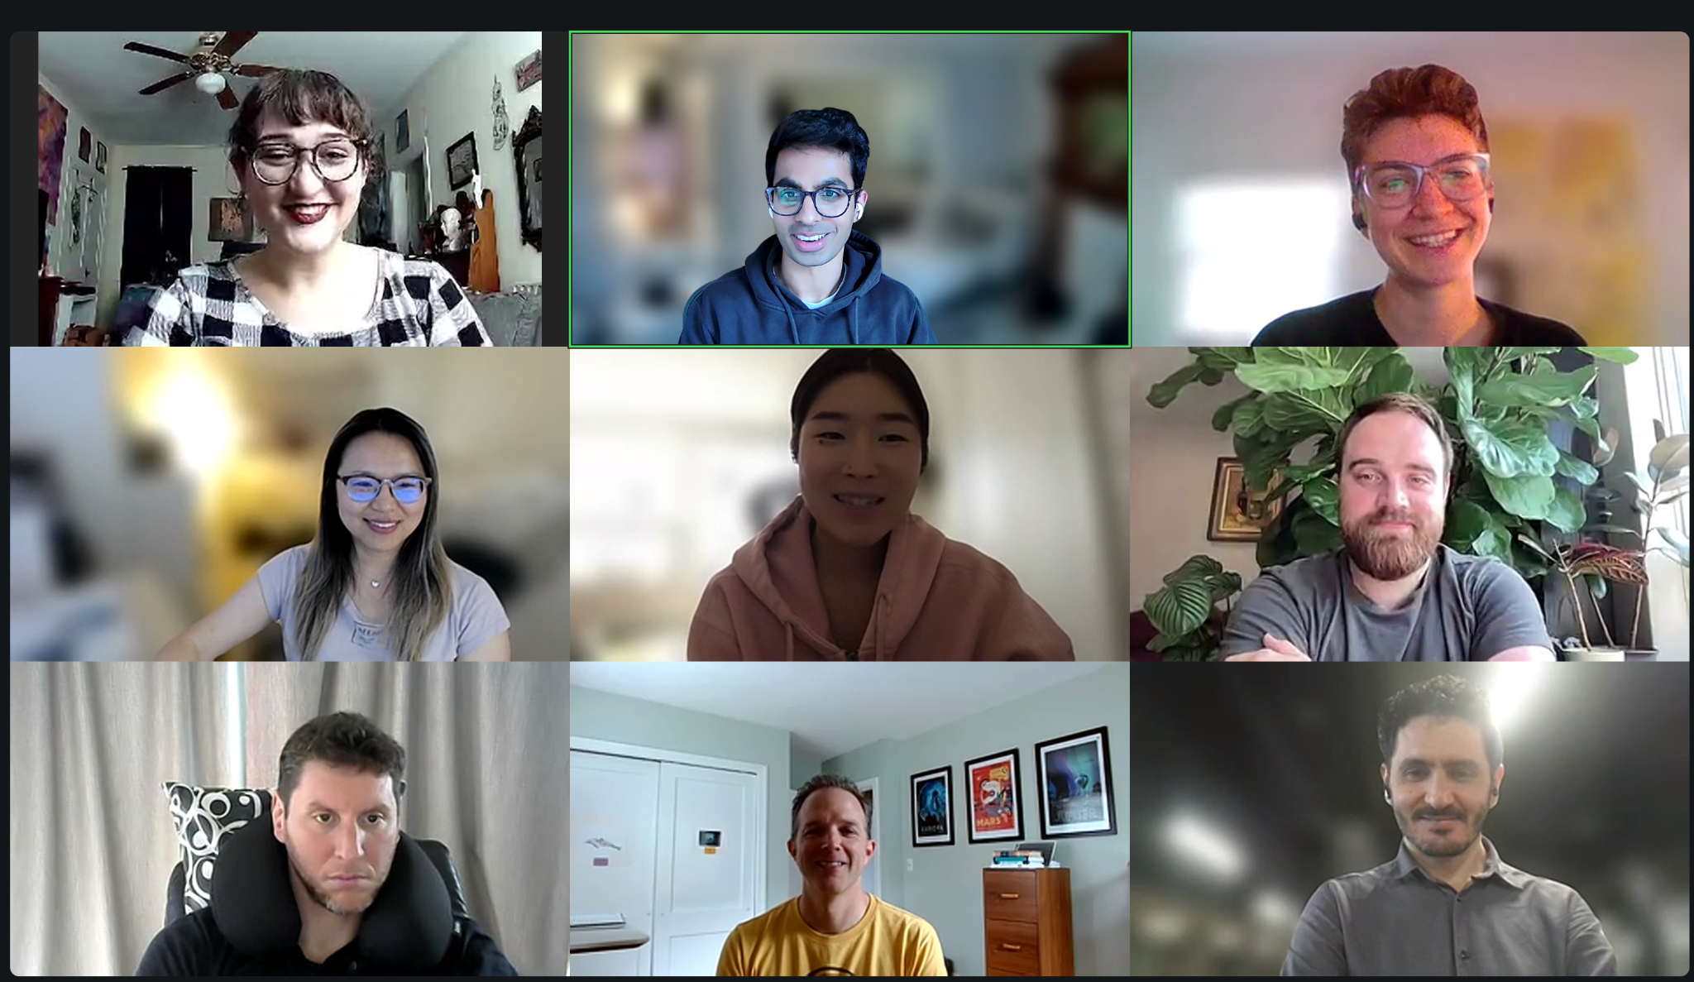
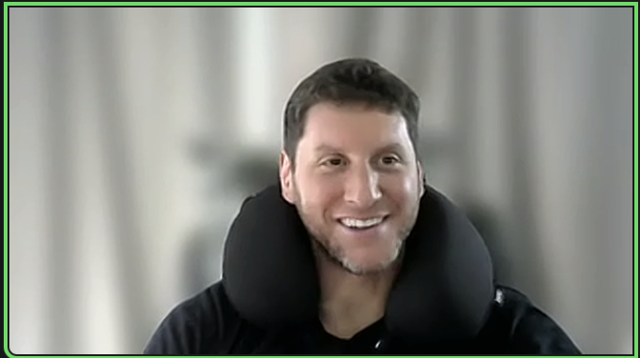
Meet the team!
Seohee Han (presenting)
Chloe K. (presenting)
Arjun Puri (presenting)
Xiaoxiao Lin (presenting)
Miranda Gonzales (presenting)
Andrew Richmond
Lucas Baldezzari
Niccolò Totis
Erik Ruzek (presenting)

Slide 3
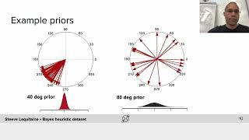
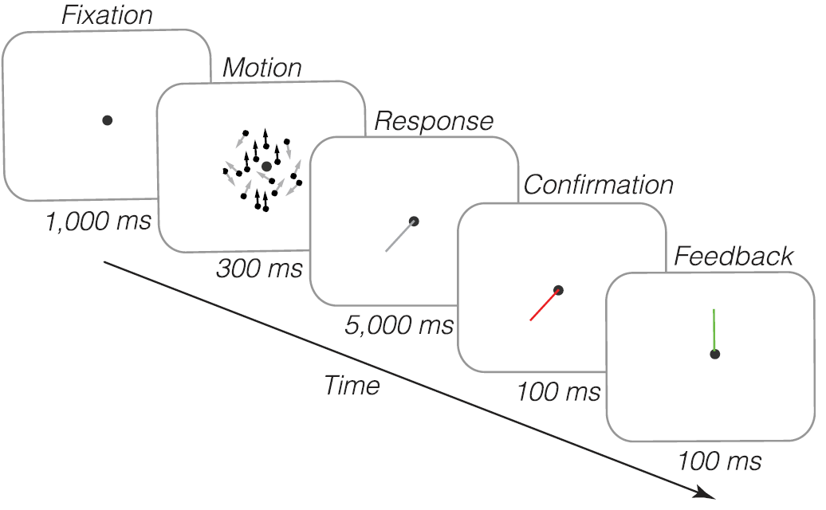
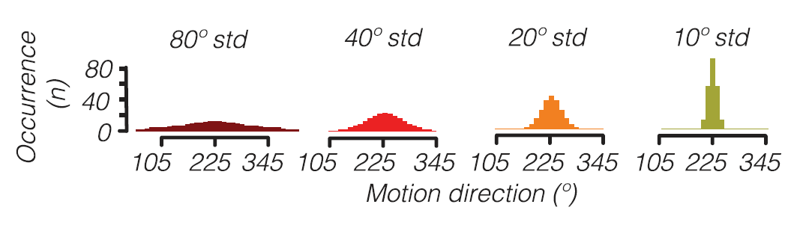
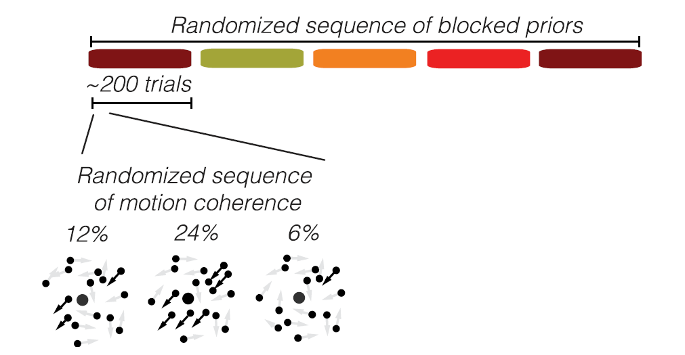
MOTION DIRECTION TASK
6-9 sessions
5 blocks per session
Notes:
Xiaoxiao

Slide 4
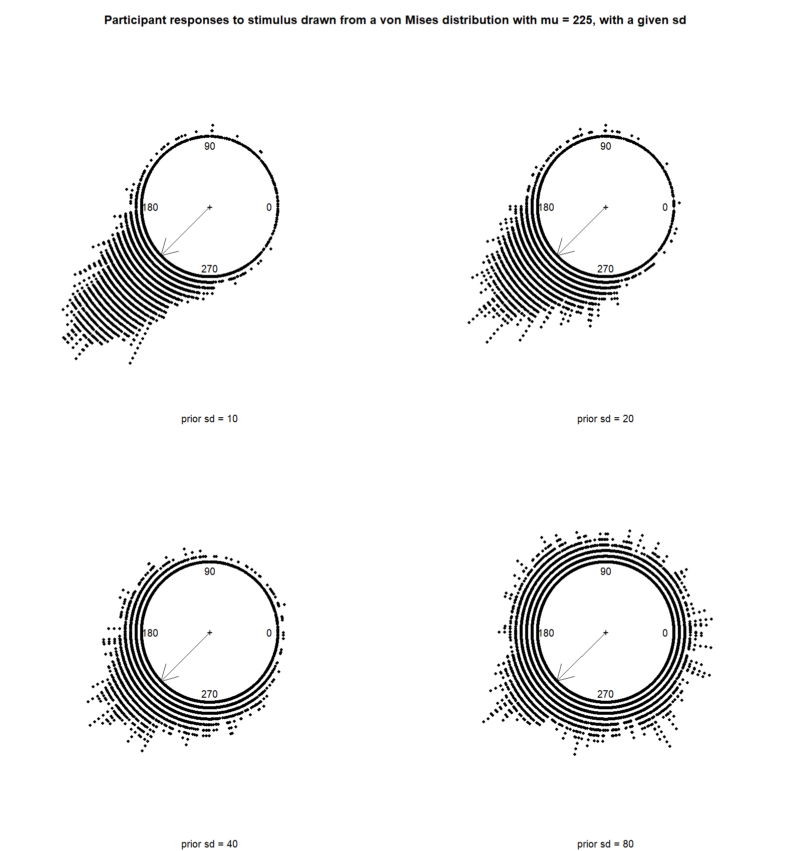
Notes:
Erik

Slide 5
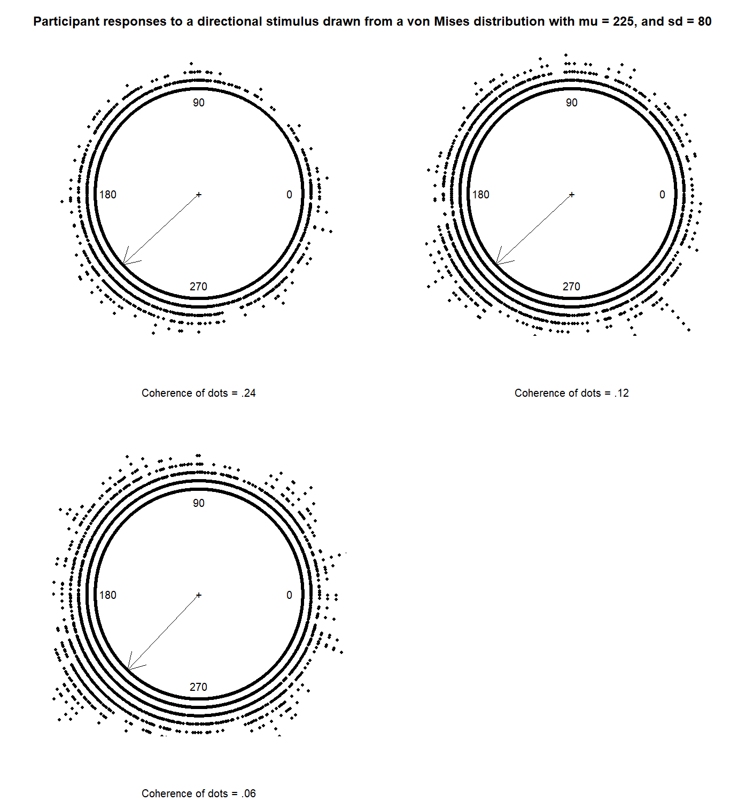
Responses for prior SD 80 at Different Coherences
Notes:
Erik

Slide 6
Research question
How does the switching behavior occur?
How does learning priors affect switching?
Approaches
Recreating the bimodal distribution with a Switching Behavior model like L&Q (2017)
Identifying latent states with Hidden Markov Modeling
Exploring how…underlying mechanisms in a Spiking Neural Network model
Notes:
Miranda. Was there learning across runs?

Slide 7
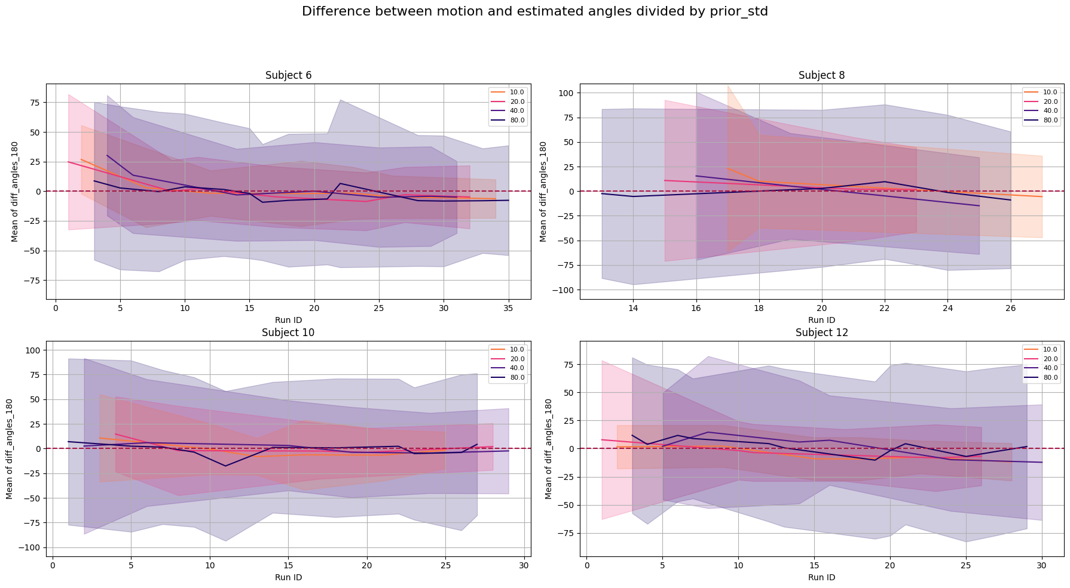
Learning across blocks
Notes:
Miranda

Slide 8
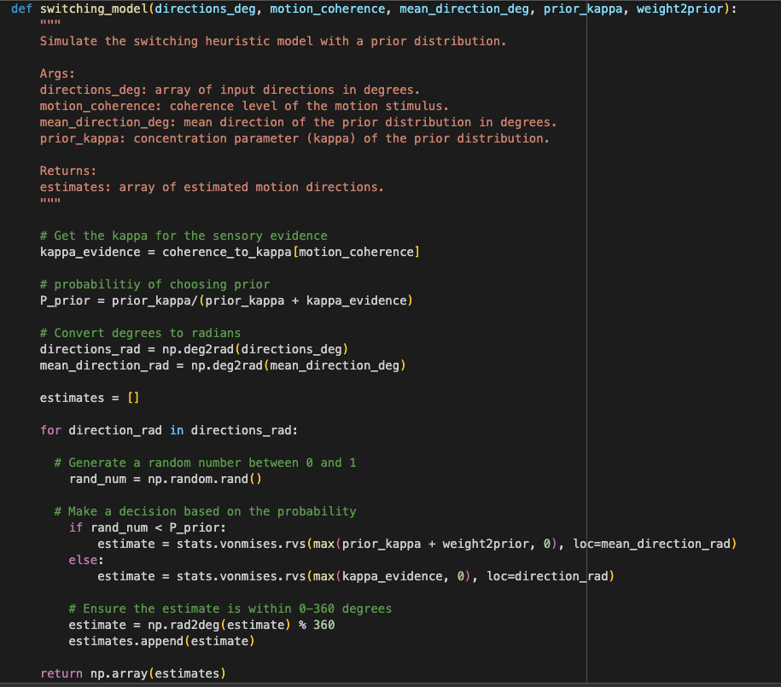
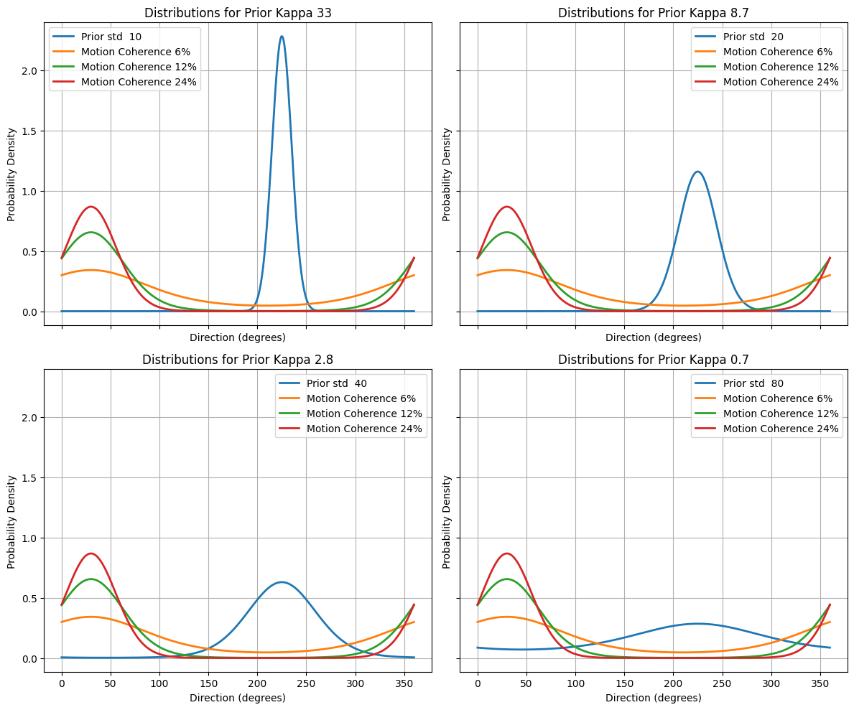
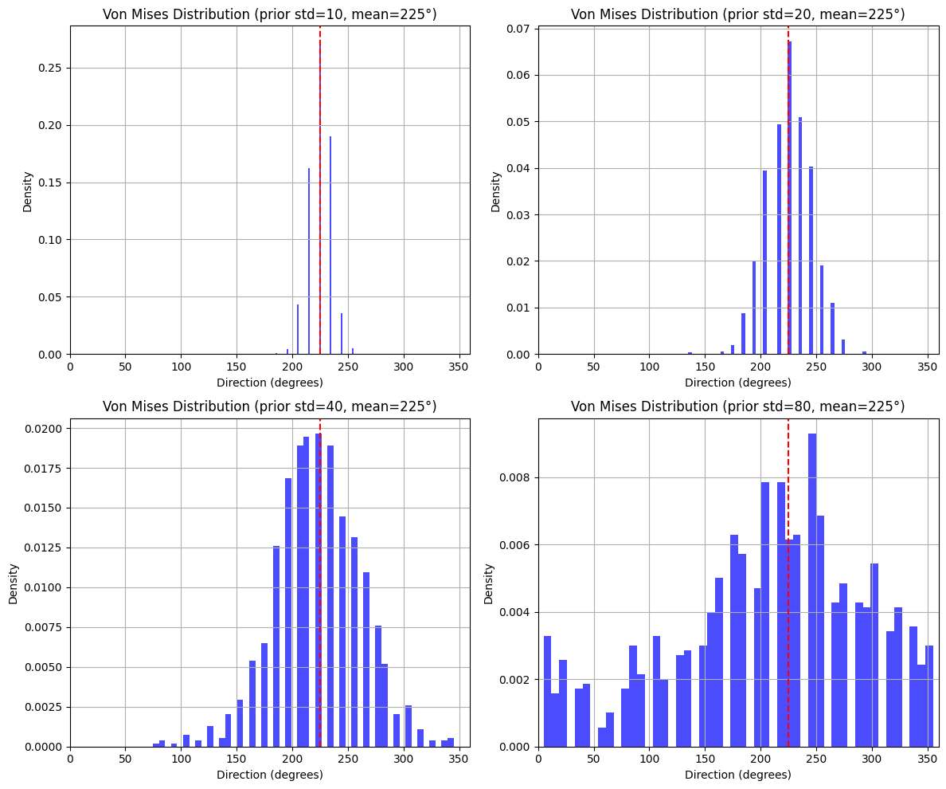
Recreating switching observer model
Generate Inputs
Generate prior and sensory distribution
Implement the Switching observer Model

Slide 9
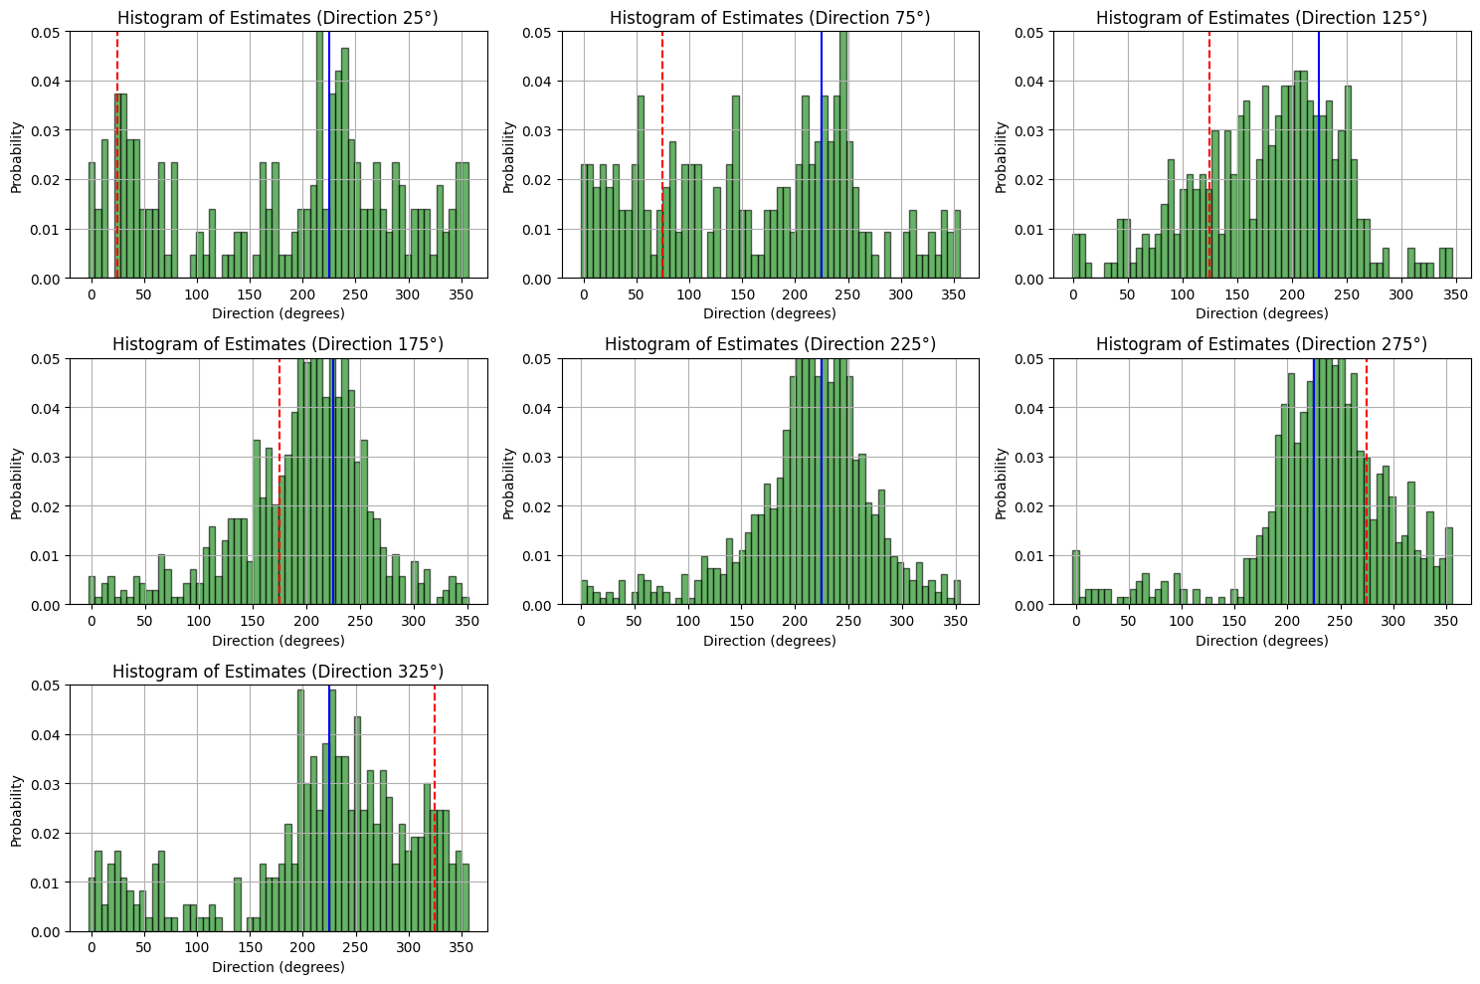
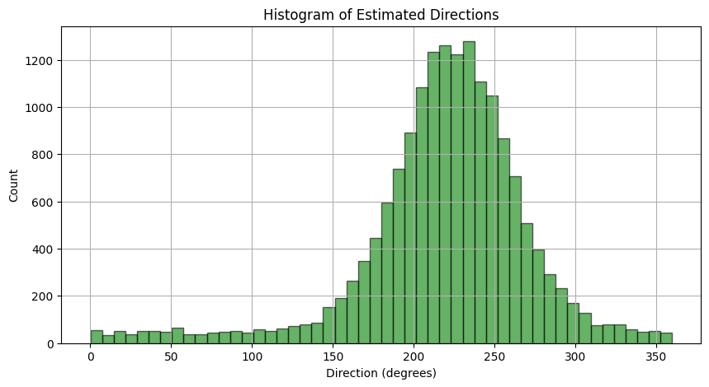
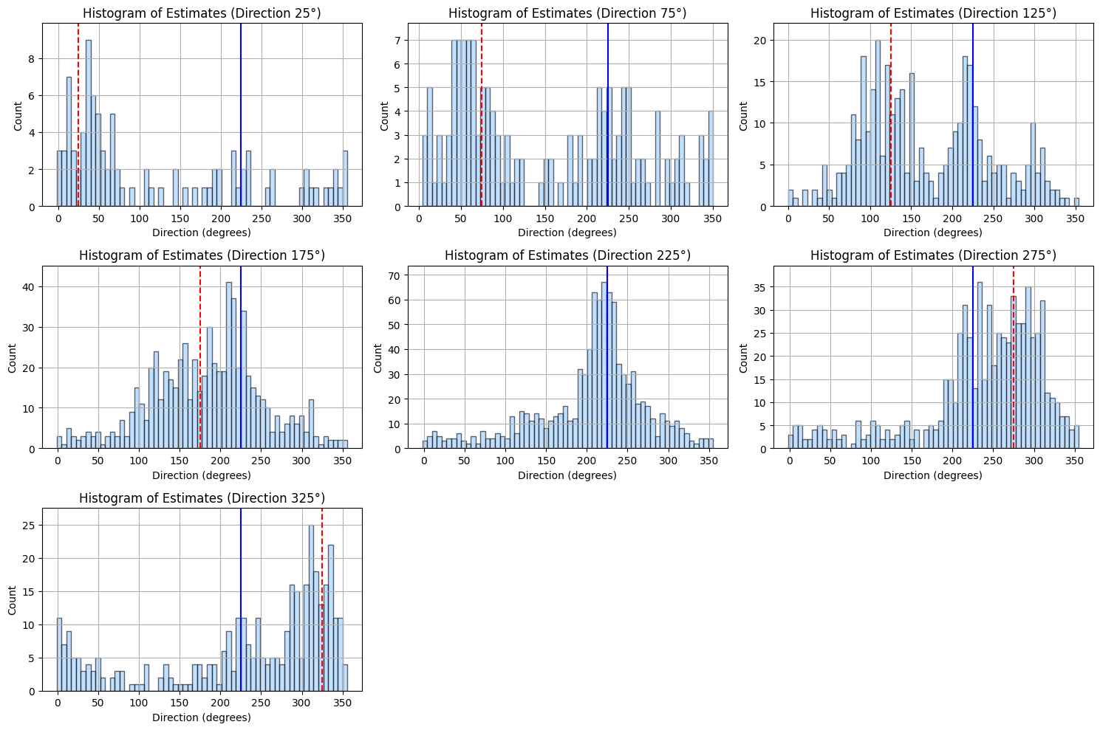
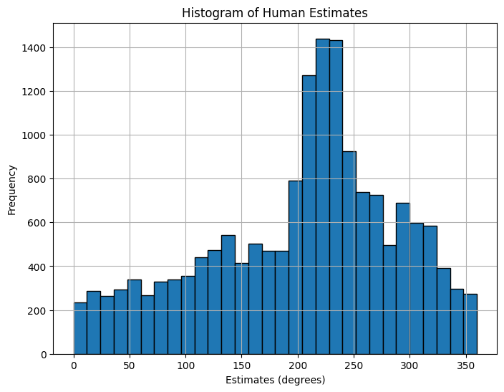
Recreating switching observer model
4. Fit the Model to Human Data

Slide 10
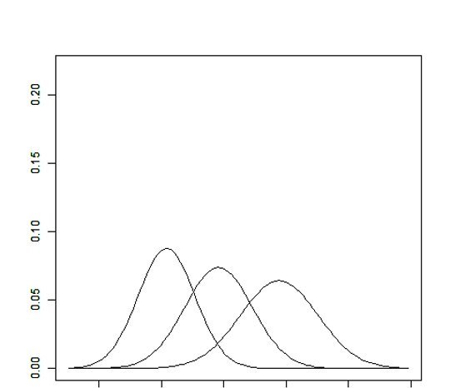
Hidden Markov Models Refresher
Switching between latent states
States have unique distributions
DATA SET
State transition probabilities
Two States?
Iterative modeling process
1
1
2
1
2
State One
State Two

Slide 11
Are there Two States?
 | State 1 (49%) | State 2 (20%) | State 3 (31%)
Response Error (sd) | 0.35 deg (20) | 0.32 deg (65) | 2.7 deg (70)
Reaction Time (sd) | 1.3s (0.4) | 1.7s (0.55) | 1.2s (0.28)
Modeled Behavior:
Response error (gaussian)
Reaction time (gaussian)
NStates (AIC):
2 States (587942)
3 States (581806)
Transition Probability Matrix (TPM)
 | S1 | S2 | S3
S1 | .87 | .04 | .09
S2 | .08 | .87 | .05
S3 | .05 | .05 | .90
Covariates:
Each covariate level has own TPM
Motion Coherence
Angle distribution strength
Adding both improved model fit
3 States + 2 cov (578085)

Slide 12
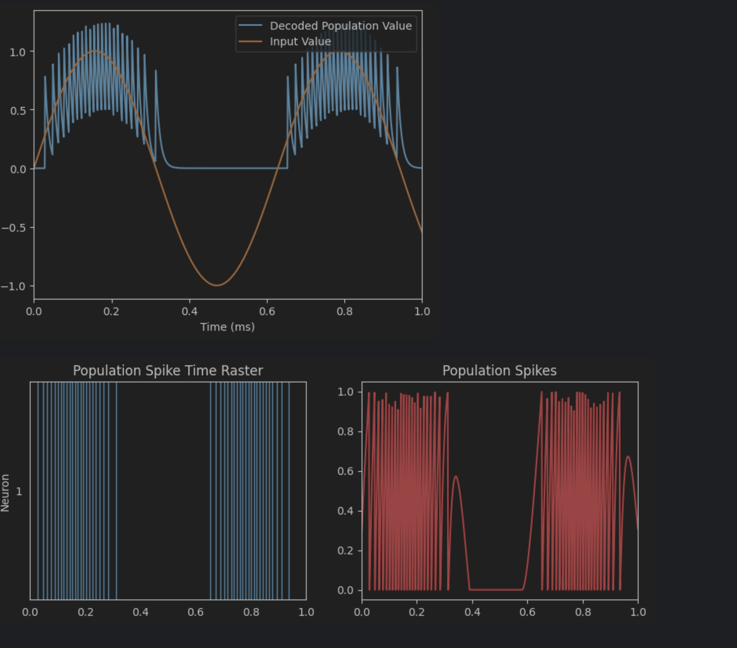
Underlying Neural Mechanisms
Summary
Stage 1: Representing one dimensional inputs
Worked within the NEF / Semantic Pointer Architecture framework by Chris Eliasmith.
Input signals are encoded into populations of neurons (individual neurons learn features to encode). Values are decoded from neuron spiking behavior.
Three stages
Represent a scalar
Learn a scalar
Learn a motion vector

Slide 13
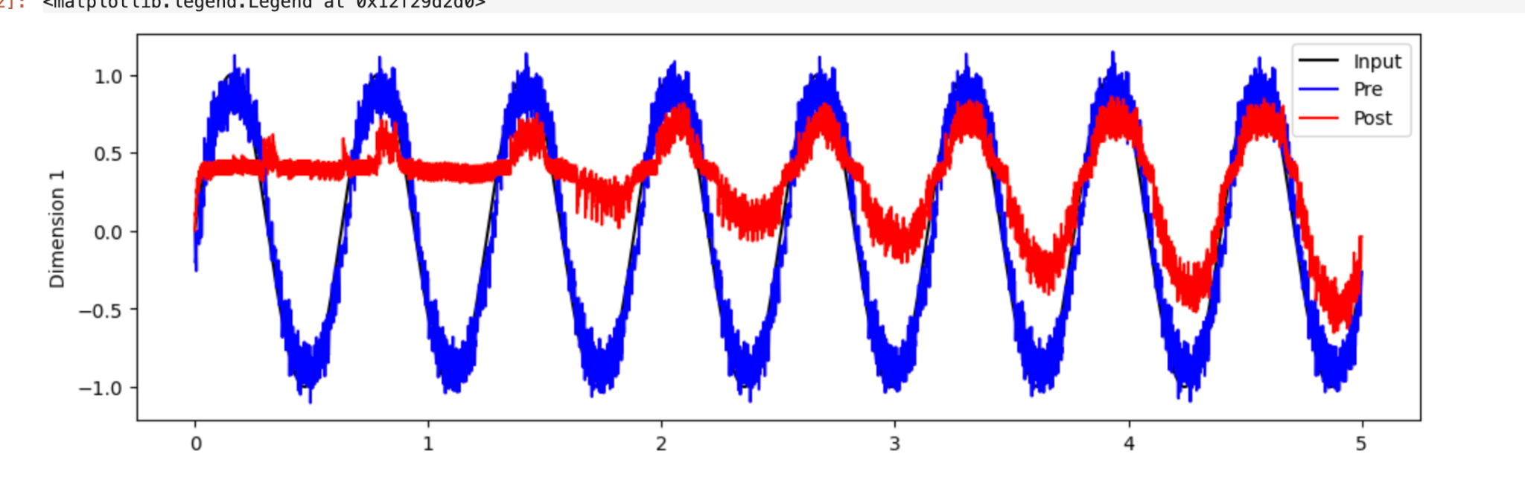
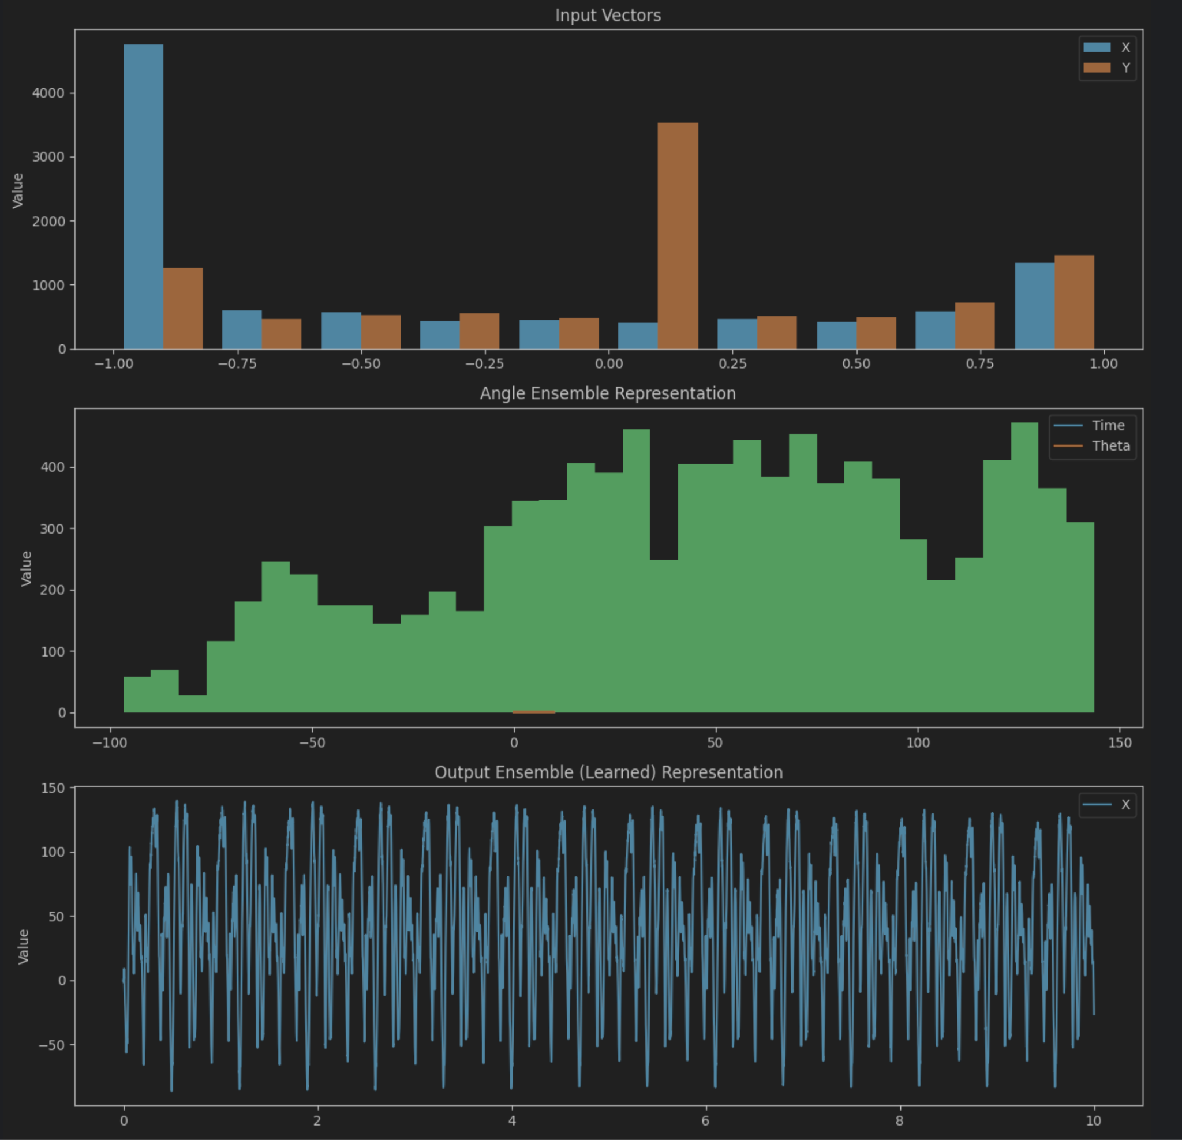
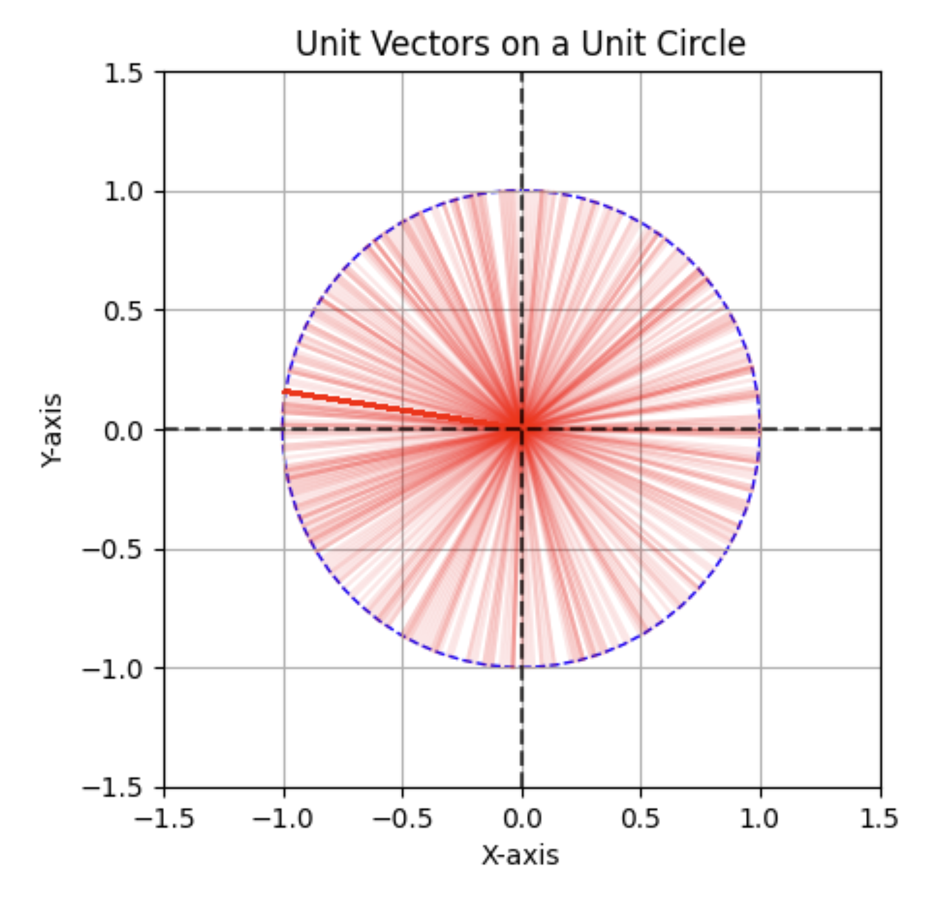
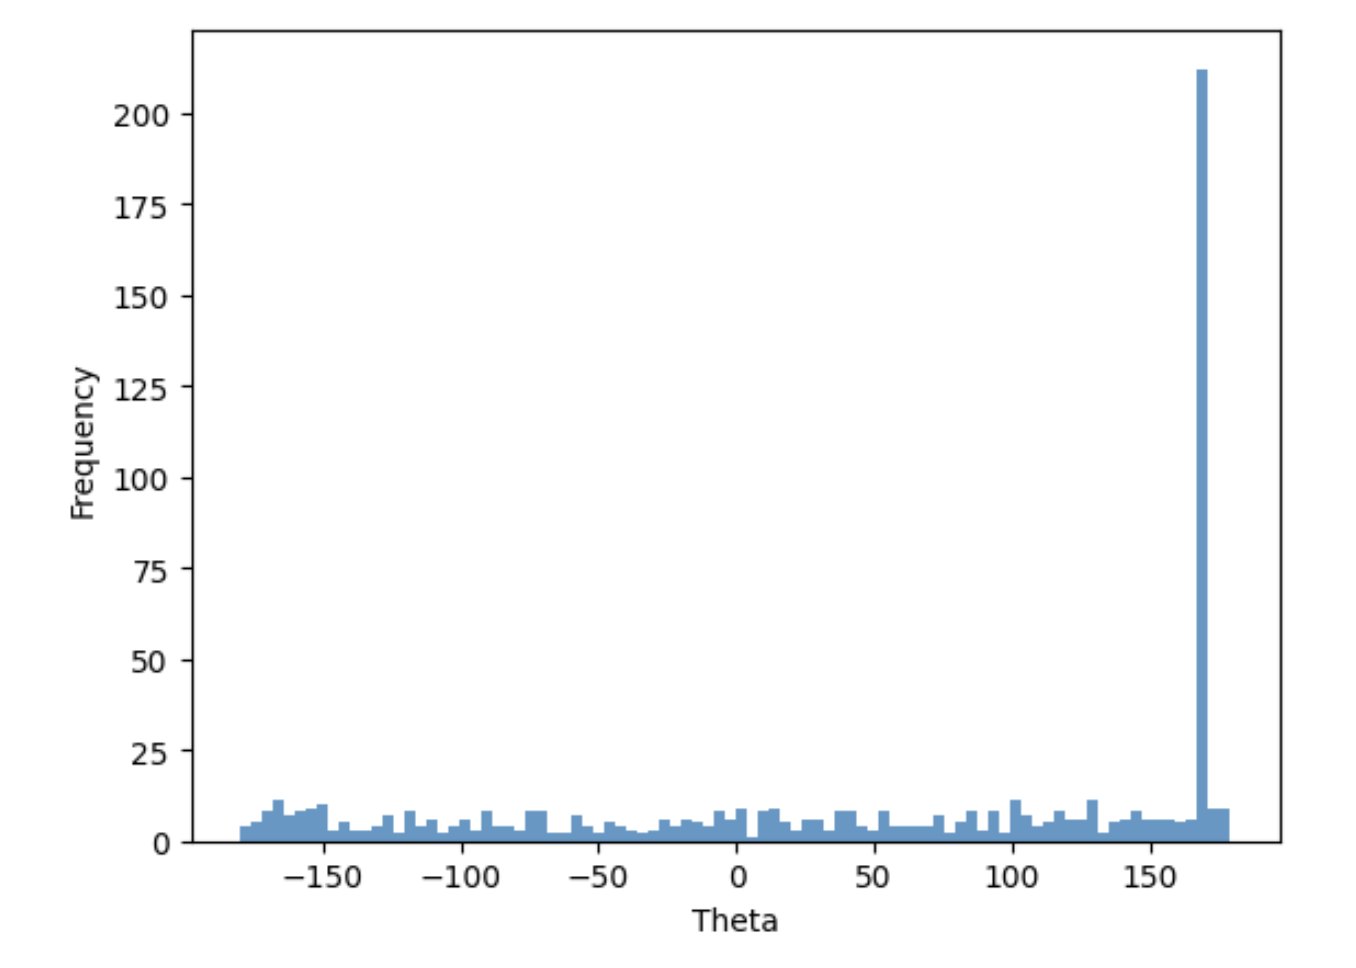
Stage 2: A learning circuit
Stage 3: Learning motion vector (not finished)

Slide 14
Conclusion
Lots of potential for future exploration.
It’s nice working within a theoretical framework.
The line between biologically plausible vs not is a hard one to walk - frameworks capture complexity which is nice.

Slide 15

THANKS!
Do you have any questions?
Connect with us on LinkedIn!
Github Repo:
https://github.com/lucasbaldezzari/babesbayes-nma

Slide 16
Ideas for the future

